Slide 1





Target Setting & Reporting
Determination • Aspiration • Respect • Equality

Slide 2


Highlands School
Could do better.
Determination • Aspiration • Respect • Equality

Slide 3
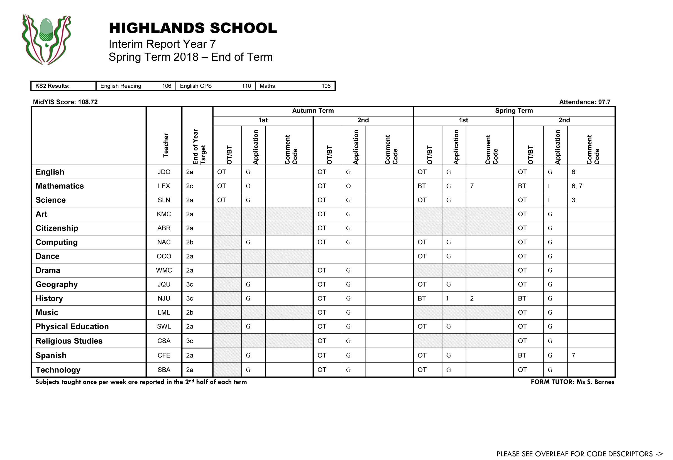

Slide 4
Subjects & Staff

Slide 5
Subjects & Staff
KS2 Results

Slide 6
Subjects & Staff
KS2 Results
MidYIS Score

Slide 7
Subjects & Staff
KS2 Results
MidYIS Score
Attendance

Slide 8
Subjects & Staff
KS2 Results
MidYIS Score
Attendance
Reporting session

Slide 9
Subjects & Staff
KS2 Results
MidYIS Score
Attendance
Reporting session
  cumulative

Slide 10
Subjects & Staff
KS2 Results
MidYIS Score
Attendance
Reporting session
  cumulative
Target Grade

Slide 11


Highlands School
Setting a Target Grade
End of KS2 scores in English & Maths
Determination • Aspiration • Respect • Equality

Slide 12
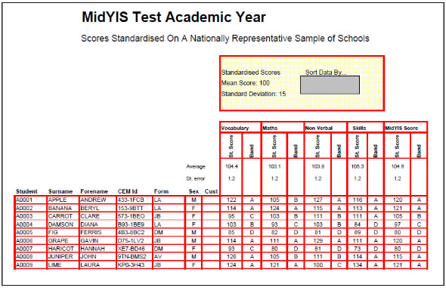
Highlands School
Setting a Target Grade
End of KS2 scores in English & Maths
MidYIS testing
Determination • Aspiration • Respect • Equality

Slide 13

Highlands School
Setting a Target Grade
End of KS2 scores in English & Maths
MidYIS testing
Baseline assessments
Determination • Aspiration • Respect • Equality

Slide 14
KS2 Results
MidYIS
Target Grades

Slide 15

Highlands School
Setting a Target Grade
Prediction
Determination • Aspiration • Respect • Equality

Slide 16

Highlands School
Setting a Target Grade
Minimum expected
Prediction
Determination • Aspiration • Respect • Equality

Slide 17

Highlands School
Setting a Target Grade
The target represents the best grade we think the student is likely to achieve if they do their best and all goes well.
Determination • Aspiration • Respect • Equality

Slide 18

Highlands School
Setting a Target Grade
ACHIEVABLE CHALLENGE
Determination • Aspiration • Respect • Equality

Slide 19
Highlands School
Target Setting
Core Competencies
Set of statements from the National Curriculum of the skills required in each subject at different stages…
Determination • Aspiration • Respect • Equality

Slide 20
Highlands School
Target Setting
Core Competencies
ARE
Age Related Expectations
Determination • Aspiration • Respect • Equality

Slide 21
Highlands School
Target Setting
Developing – Secure - Mastering
 | Mastery |  | 3a
Above Age Related Expectations | Secure | 8 | 3b
 | Developing |  | 3c
 | Mastery |  | 2a
At Age Related Expectations | Secure | 7 | 2b
 | Developing |  | 2c
 | Mastery |  | 1a
Below Age Related Expectations | Secure | 6 | 1b
 | Developing |  | 1c
Determination • Aspiration • Respect • Equality

Slide 22
Highlands School
Target Setting
Determination • Aspiration • Respect • Equality

Slide 23
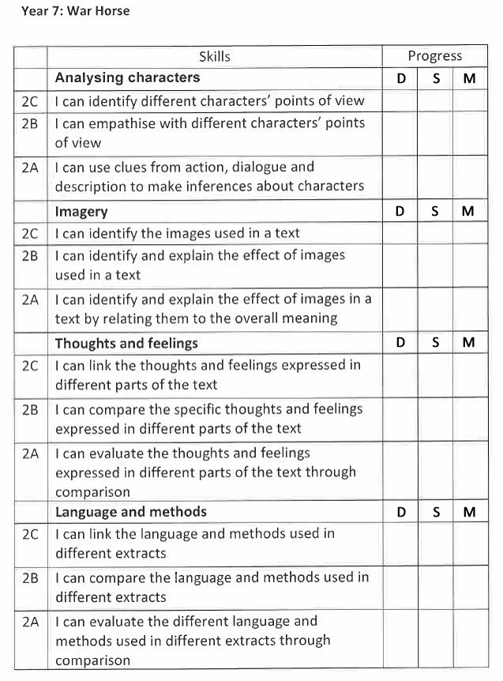
Highlands School
Target Setting
Core Competencies
Year 7 = Grade 2 ARE
Developing – Secure - Mastery
Determination • Aspiration • Respect • Equality

Slide 24
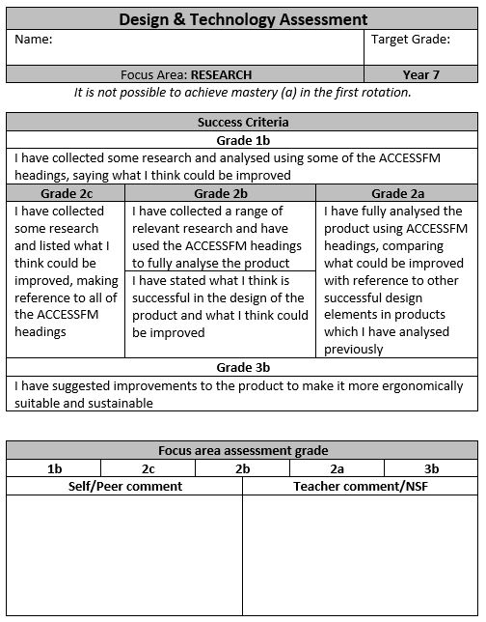
Highlands School
Target Setting
Core Competencies
Year 7 = Grade 2 ARE
Developing – Secure - Mastery
Determination • Aspiration • Respect • Equality

Slide 25
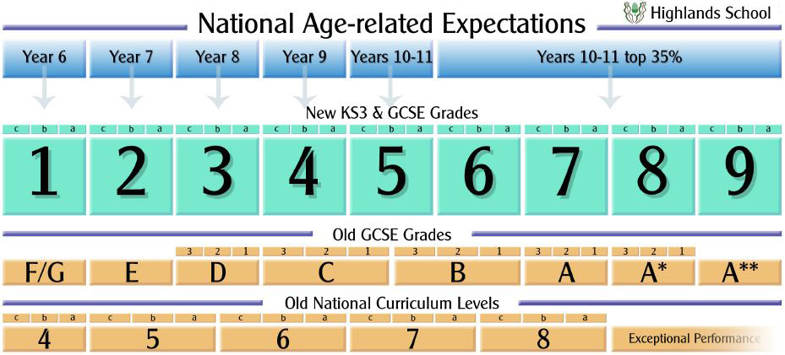
Highlands School
Determination • Aspiration • Respect • Equality

Slide 26
Highlands School
Tracking Progress toward targets
Teacher assessment
classwork & homework
Next Steps Feedback
Pupil self-assessment
Peer review
Understanding of the objectives
& knowing the targets.
Determination • Aspiration • Respect • Equality

Slide 27
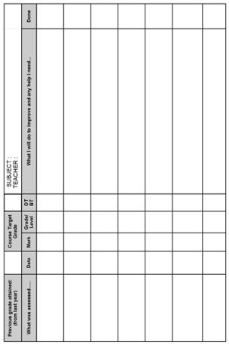
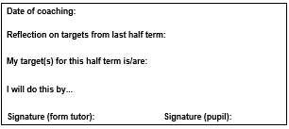
Highlands School
Tracking Progress
Progress tracker
Record of coaching sessions
Determination • Aspiration • Respect • Equality

Slide 28
Highlands School
OT/BT
On Target
Below Target

Slide 29
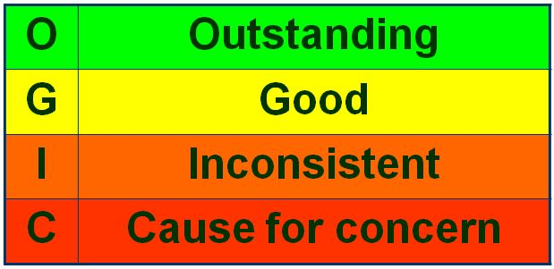
Highlands School
Application

Slide 30
Highlands School
Comment
Code
1 - 15

Slide 31
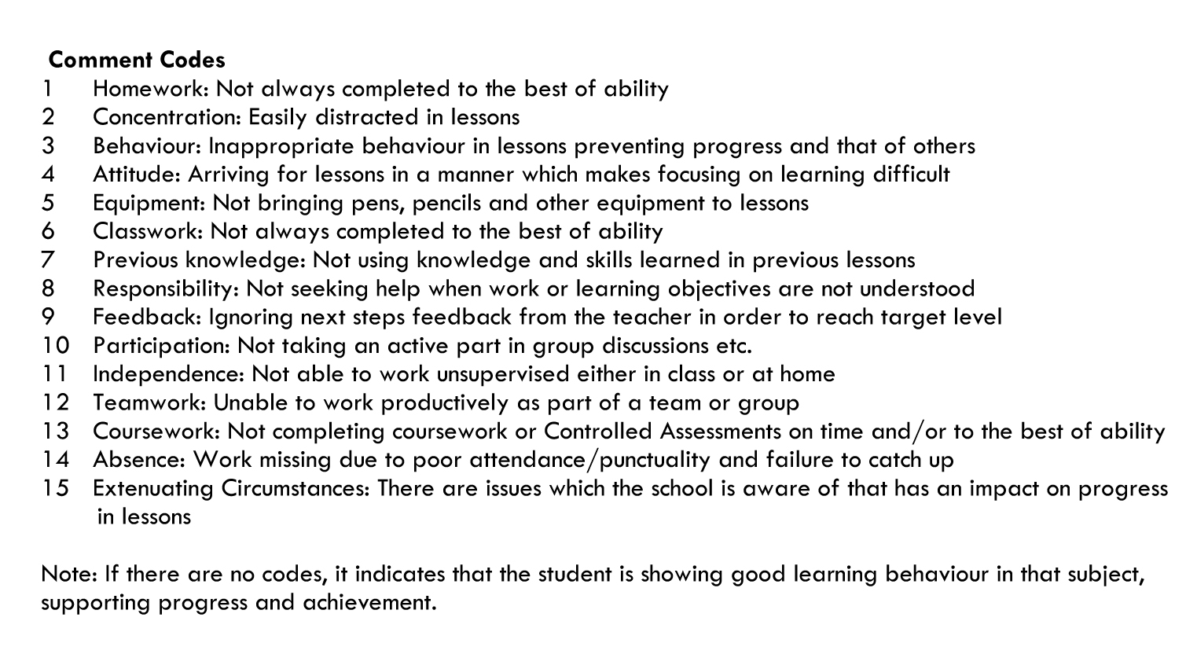
Highlands School
Comment
Code
1 - 15

Slide 32
Highlands School
Tracking Progress
Interim Report – every half-term
End of Year Report – with tutor comment
Academic Review Day – 15th November
Parents’ Evening – 1st May 2019
Determination • Aspiration • Respect • Equality

Slide 33
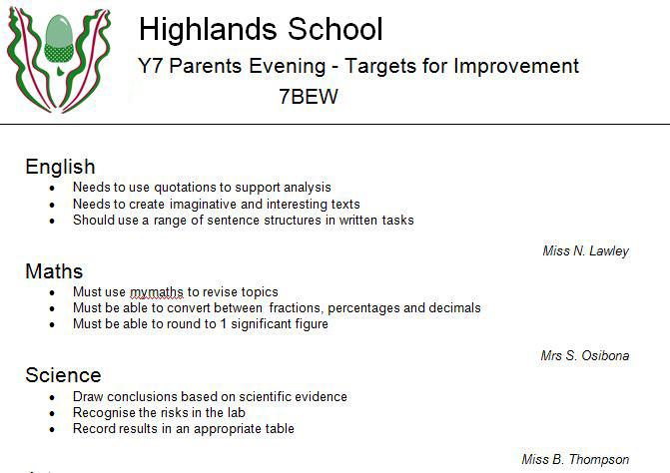
Highlands School
3 targets for each subject related directly to the curriculum
Presented upon arrival
Determination • Aspiration • Respect • Equality

Slide 34

Highlands School
Real-time sharing of pupil data with you to help raise student achievement
Features include:
Update personal records
View personal data held on your child
View all reports
View academic data
View behaviour information
Book Parents’ Evening appointment
Determination • Aspiration • Respect • Equality

Slide 35
Highlands School
Could do even better
… and this is how.
Determination • Aspiration • Respect • Equality

Slide 36
Highlands School
Tony Smith
postbox@highlands.enfield.sch.uk
Determination • Aspiration • Respect • Equality

Slide 37
Highlands School
Academic Review Day
Thursday 15th November 2018
Individual 10 minute meetings with the form tutor.
Determination • Aspiration • Respect • Equality

Slide 38
Highlands School
ORJ
Determination • Aspiration • Respect • Equality

Slide 39
Highlands School
OAD
Determination • Aspiration • Respect • Equality

Slide 40
Highlands School
RNC
Determination • Aspiration • Respect • Equality

Slide 41
Highlands School
RGA
Determination • Aspiration • Respect • Equality

Slide 42
Highlands School
WHE
Determination • Aspiration • Respect • Equality

Slide 43
Highlands School
WSW
Determination • Aspiration • Respect • Equality

Slide 44
Highlands School
BSP
Determination • Aspiration • Respect • Equality

Slide 45
Highlands School
BEH
Determination • Aspiration • Respect • Equality

